Slide 1

Review-2 (week 2&3)

Slide 2
Agenda:
1. Installation of SQL server 2019.
2. System Databases.
3. Security :
a). server roles.
b).Database roles.
4.Authentication
5. SQL Sub-Languages

Slide 3
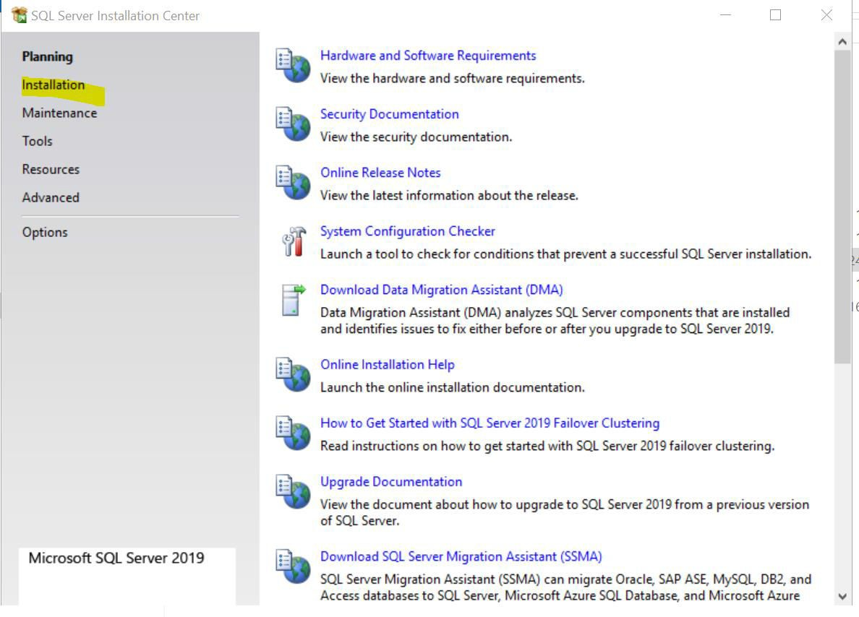
SQL server 2019 DEV END on USVAN-MES301

Slide 4
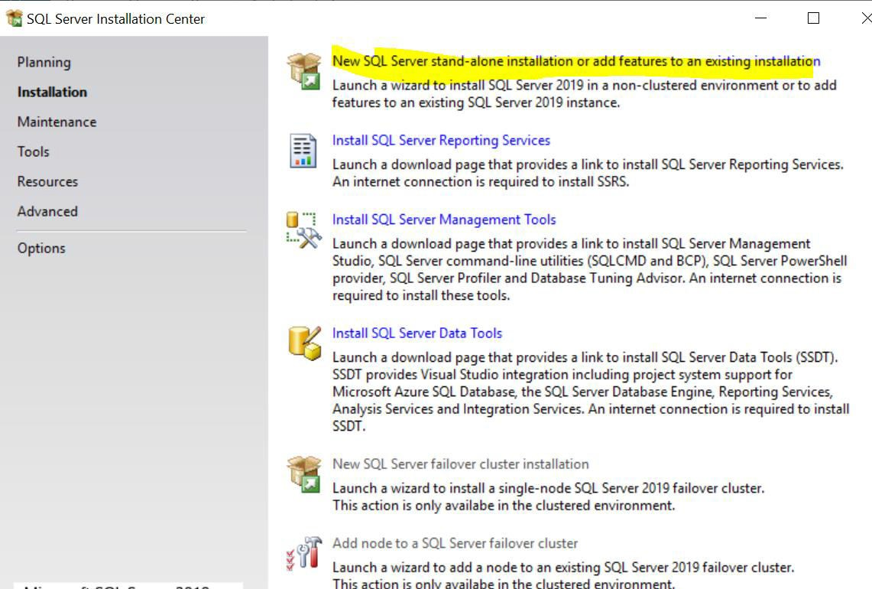
SQL server 2019 DEV END on USVAN-MES301

Slide 5
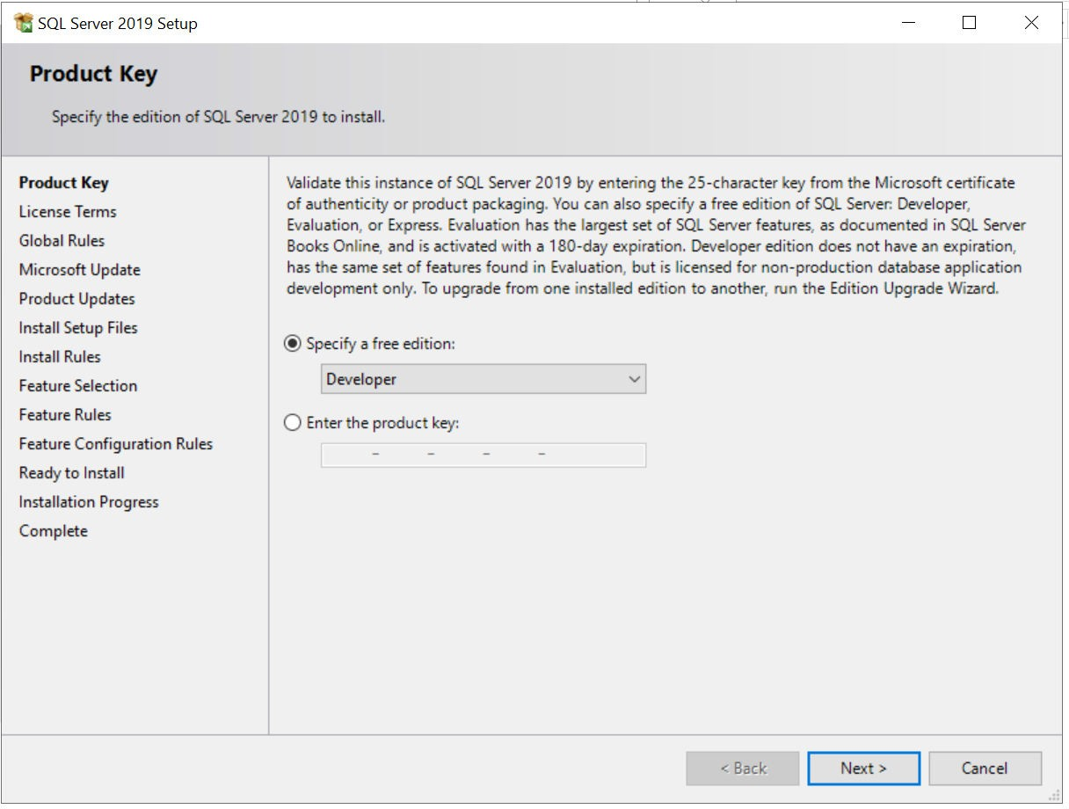
SQL server 2019 DEV END on USVAN-MES301

Slide 6
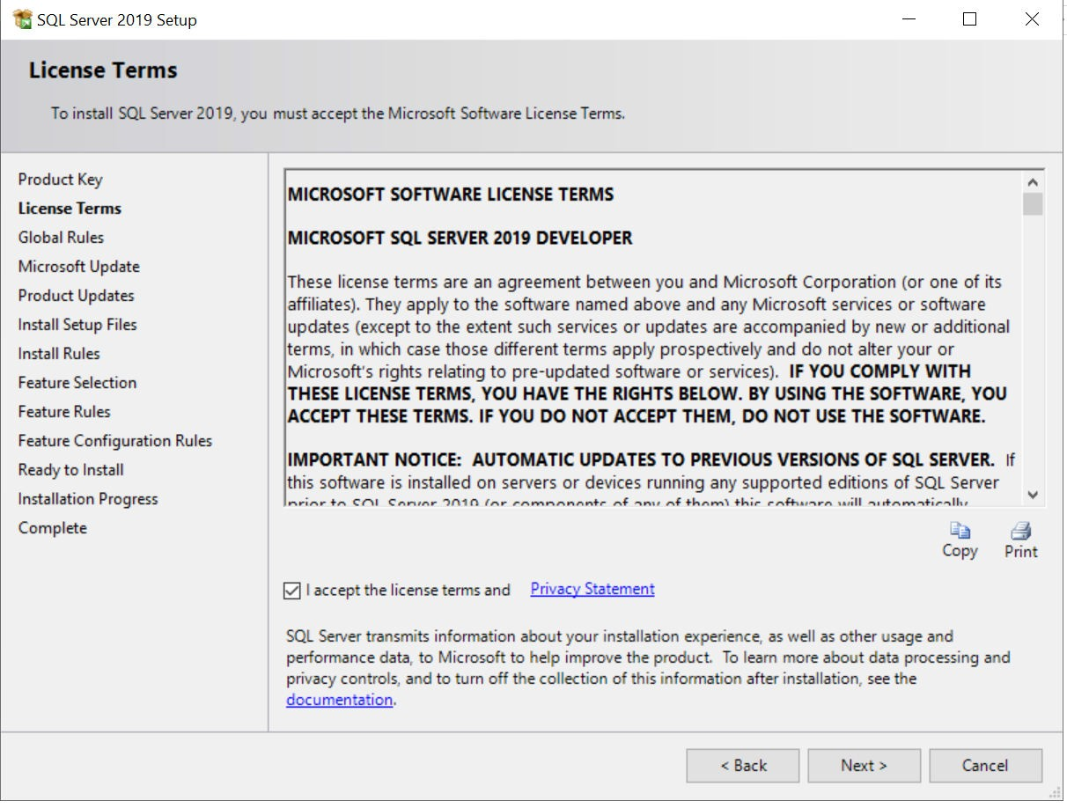
SQL server 2019 DEV END on USVAN-MES301

Slide 7
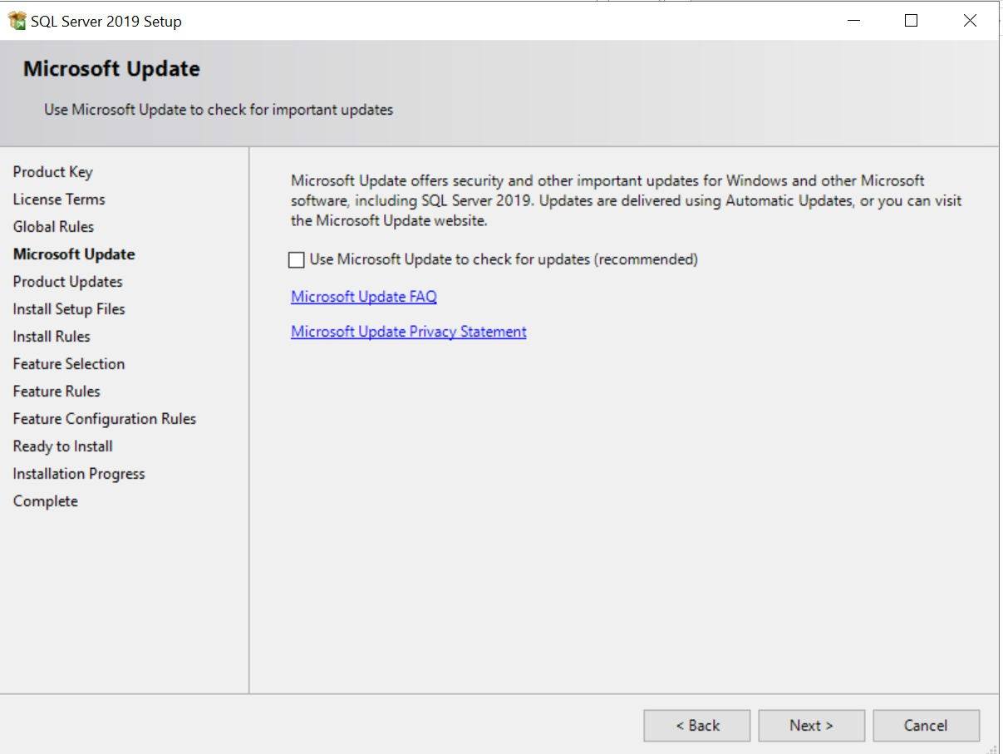
SQL server 2019 DEV END on USVAN-MES301

Slide 8
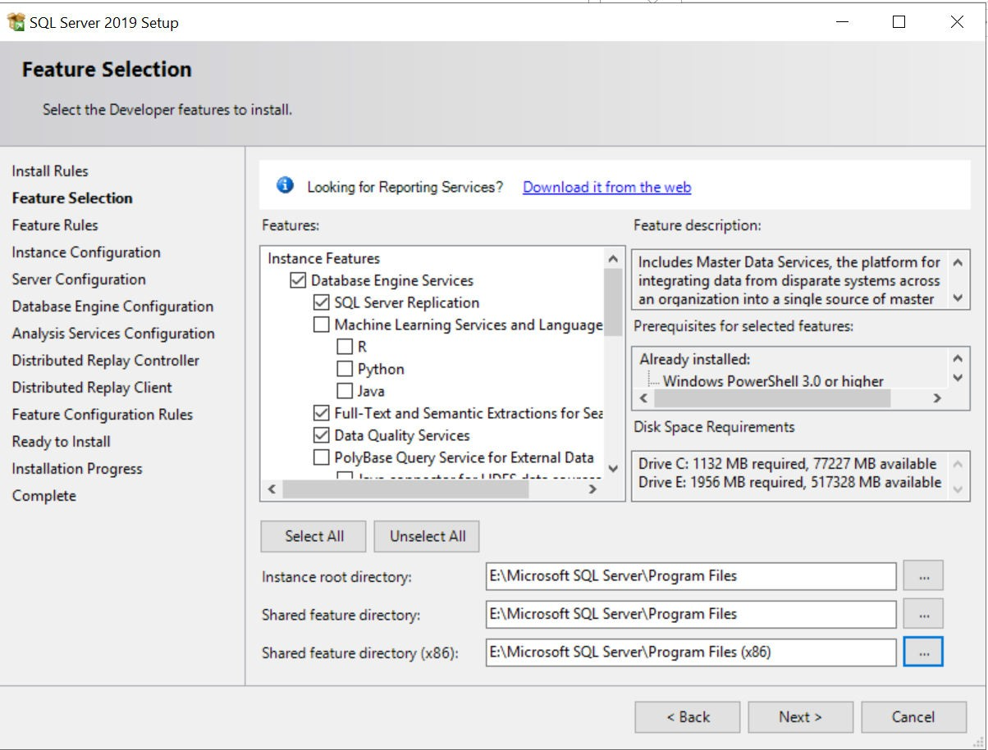
SQL server 2019 DEV END on USVAN-MES301

Slide 9
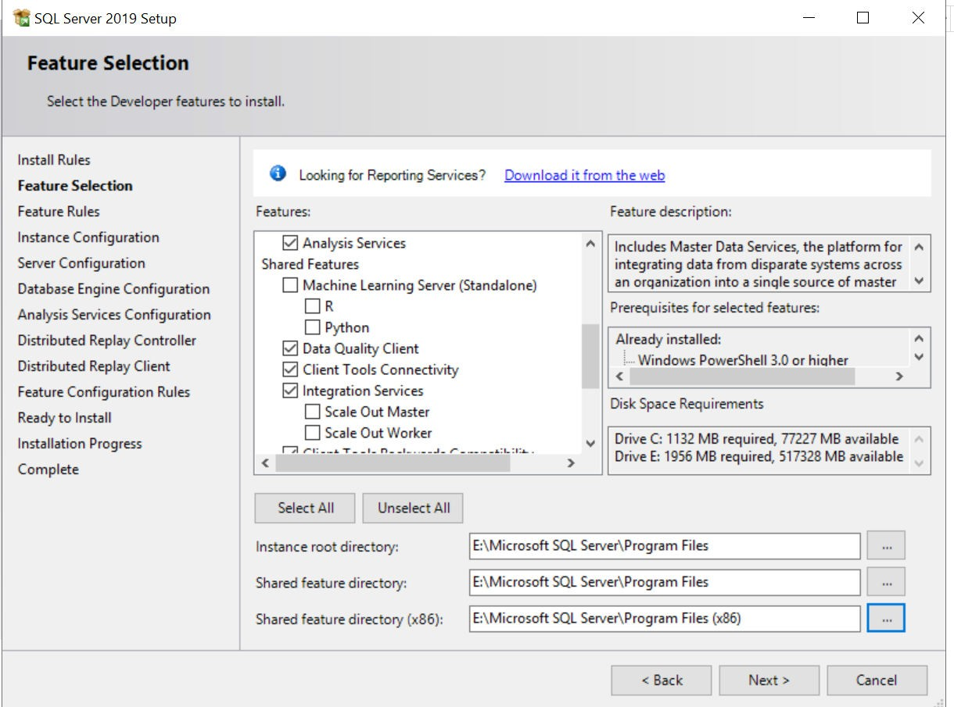
SQL server 2019 DEV END on USVAN-MES301

Slide 10
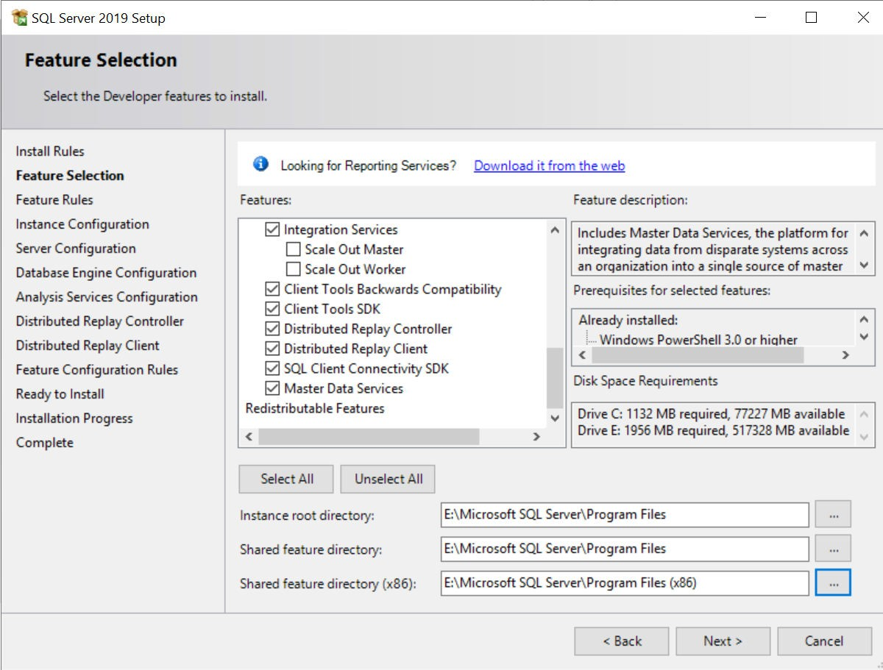
SQL server 2019 DEV END on USVAN-MES301

Slide 11
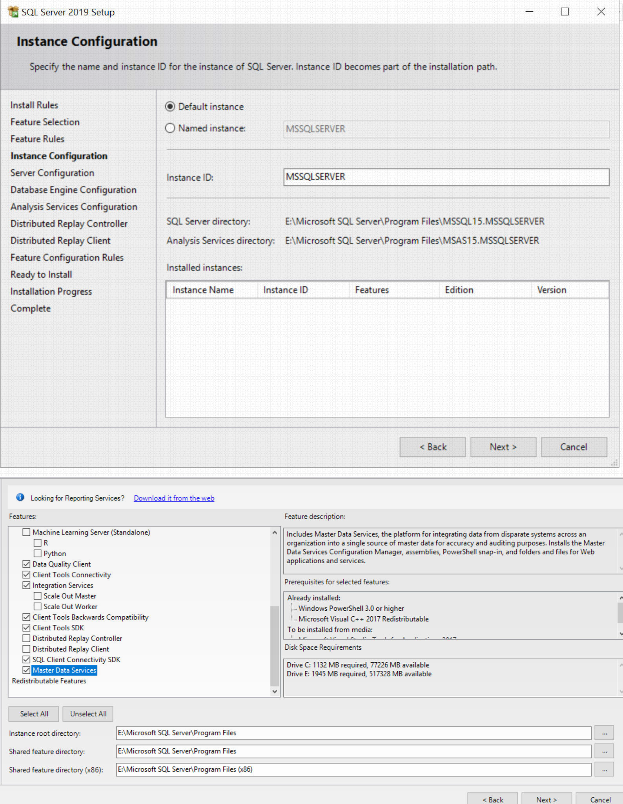
SQL server 2019 DEV END on USVAN-MES301

Slide 12
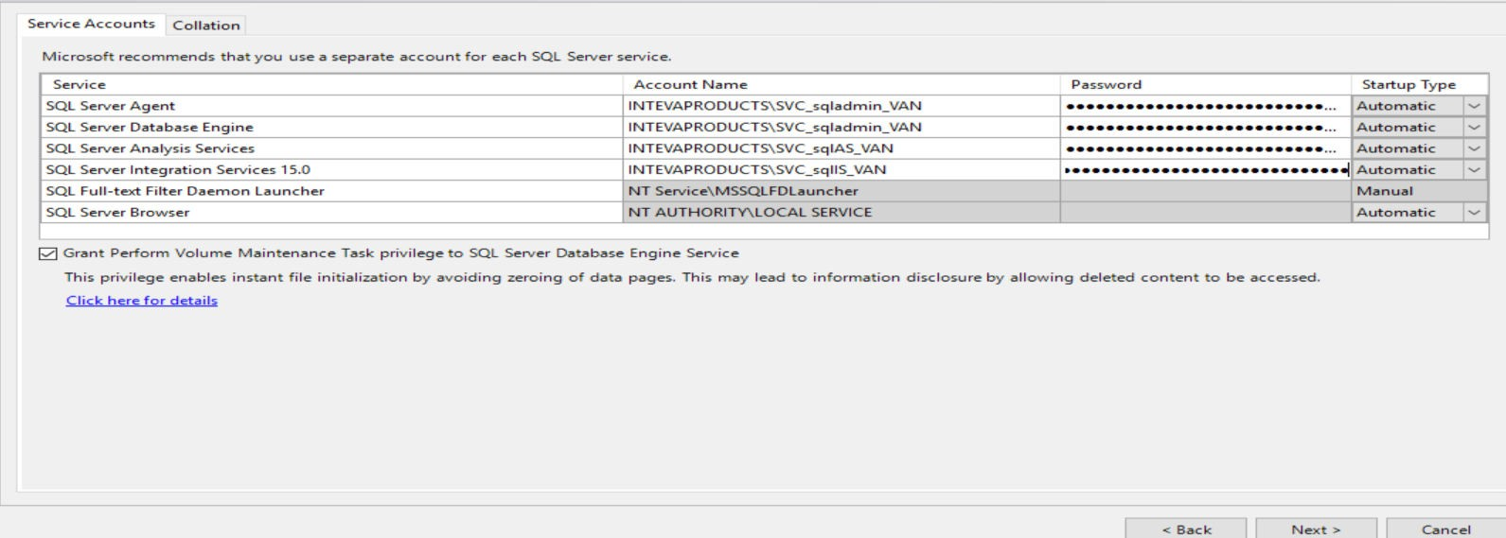
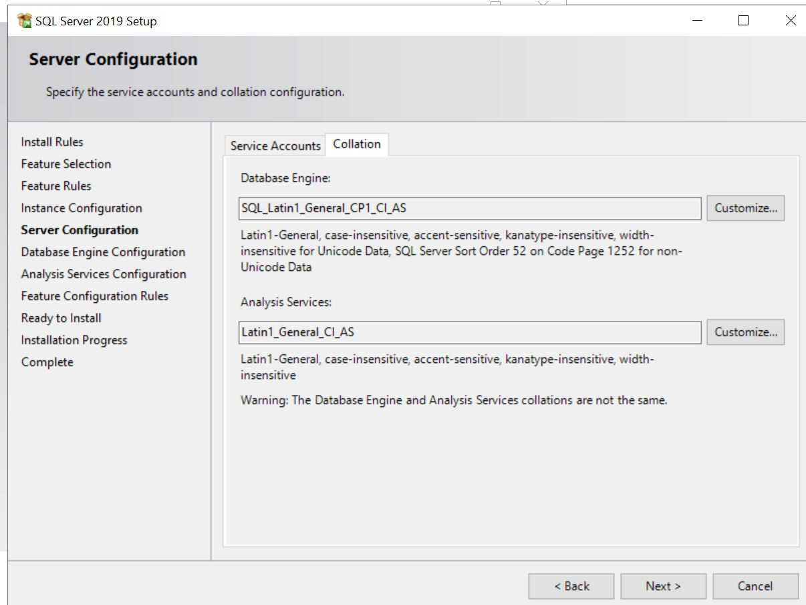
SQL server 2019 DEV END on USVAN-MES301

Slide 13
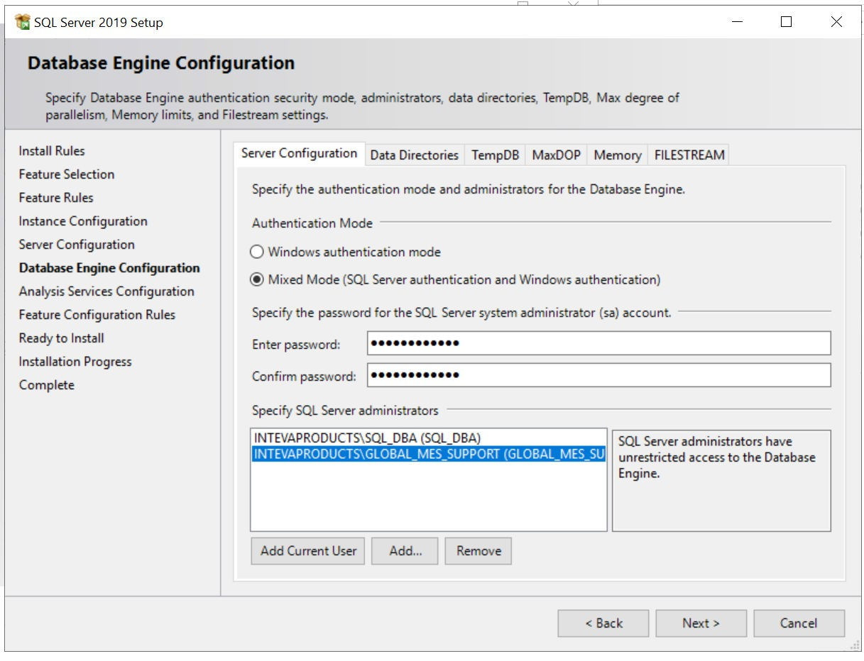
SQL server 2019 DEV END on USVAN-MES301

Slide 14
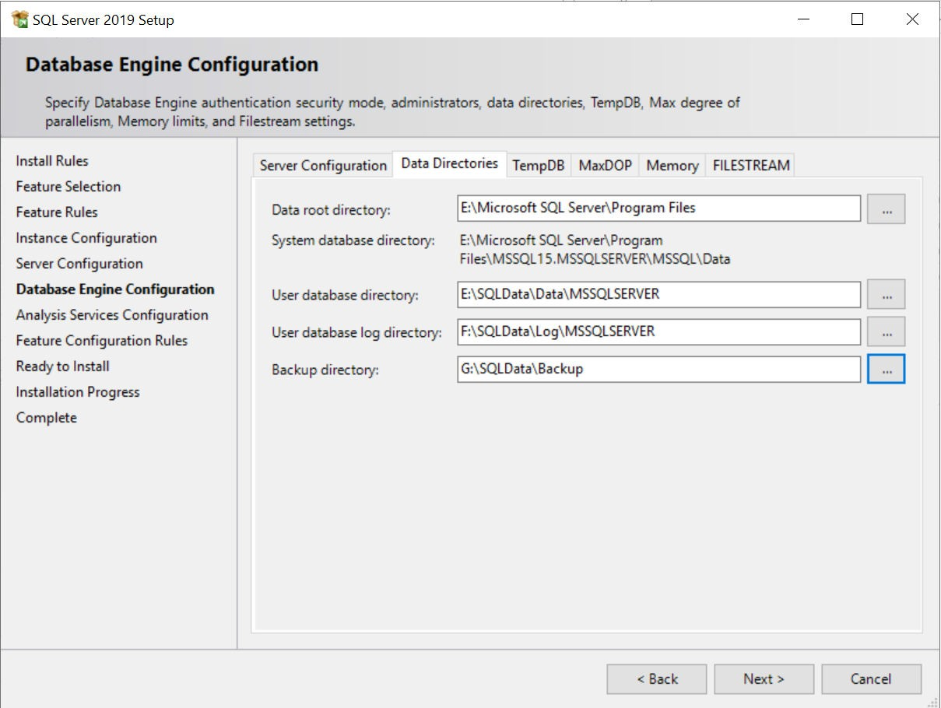
SQL server 2019 DEV END on USVAN-MES301

Slide 15
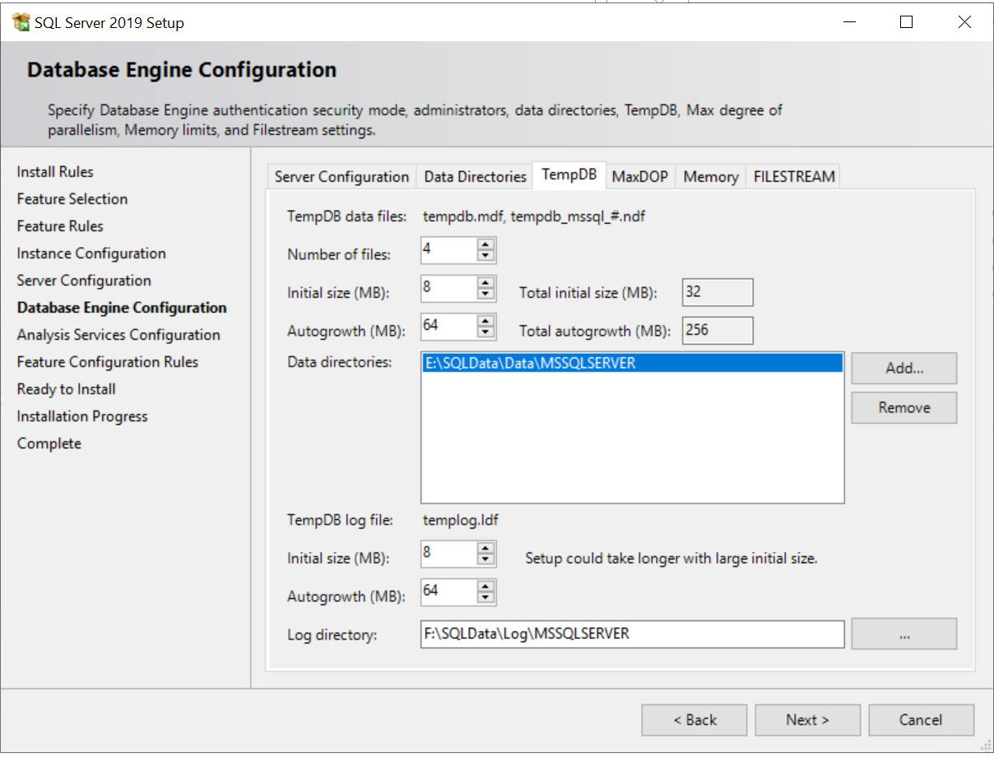
SQL server 2019 DEV END on USVAN-MES301

Slide 16
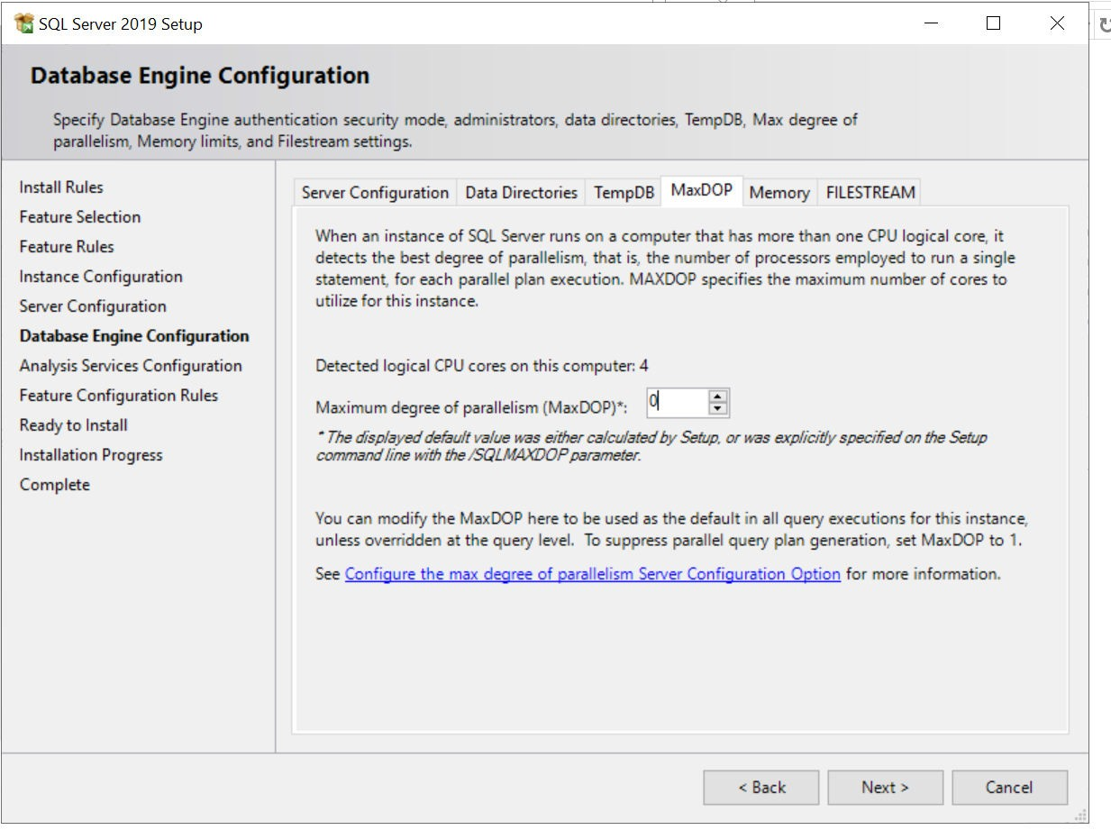
SQL server 2019 DEV END on USVAN-MES301

Slide 17
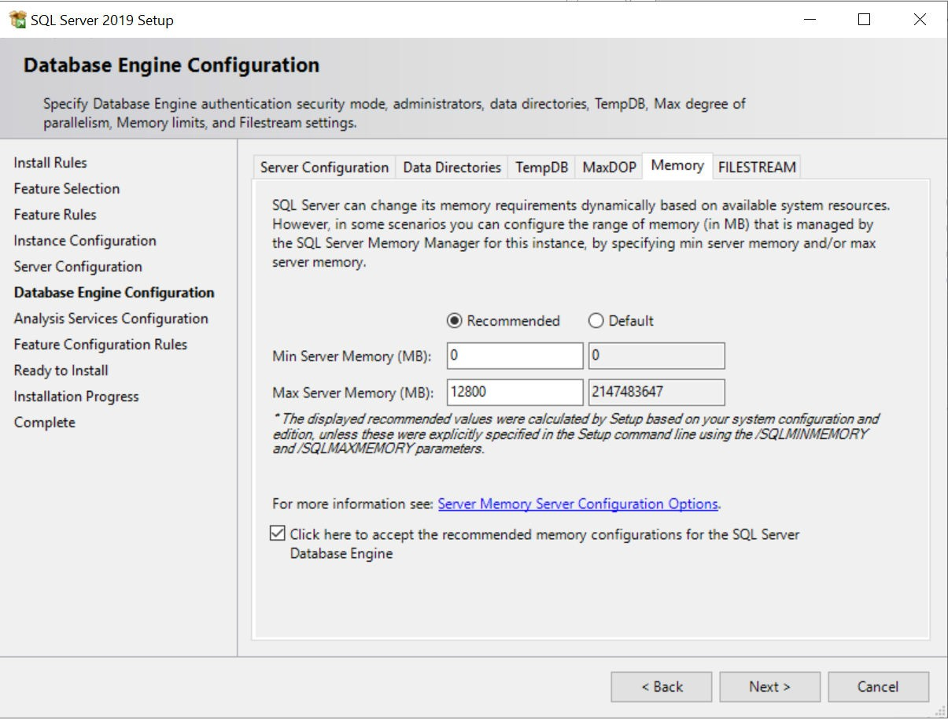
SQL server 2019 DEV END on USVAN-MES301

Slide 18
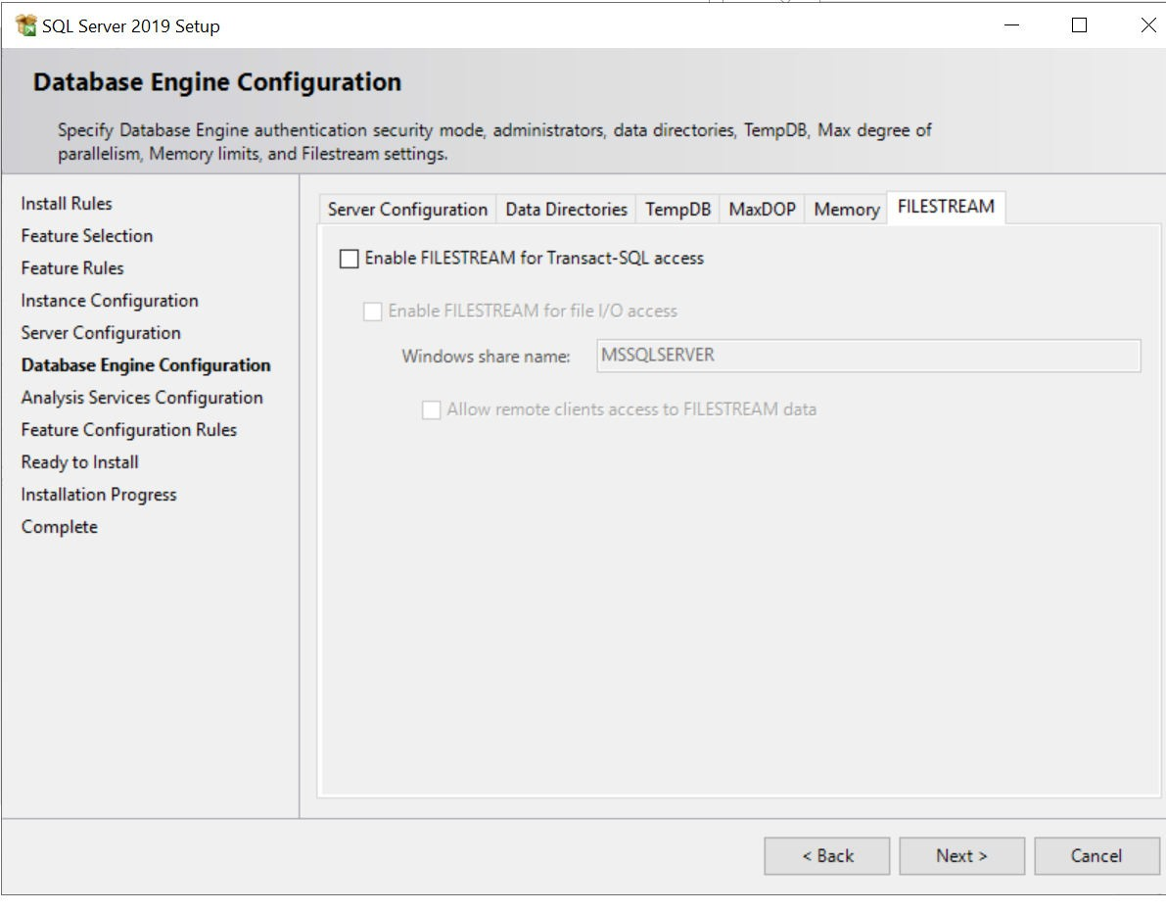
SQL server 2019 DEV END on USVAN-MES301

Slide 19
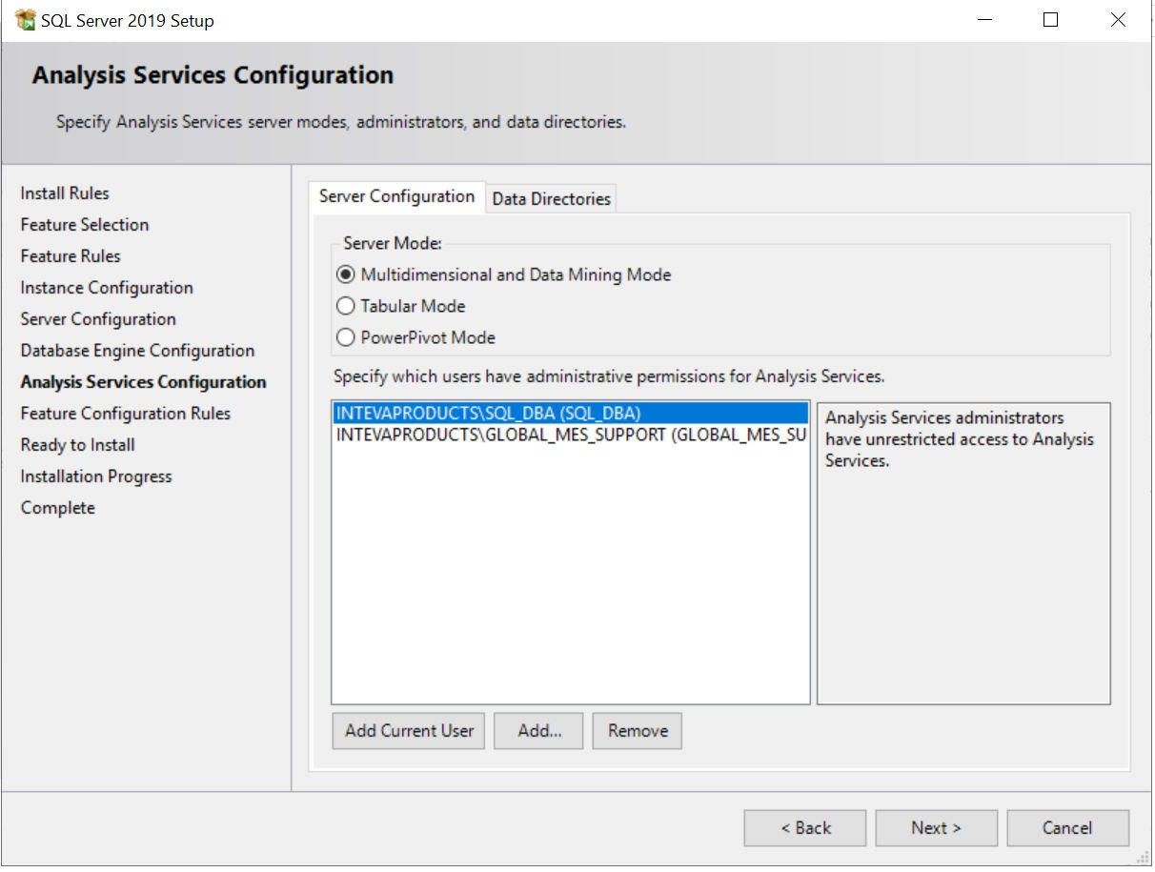
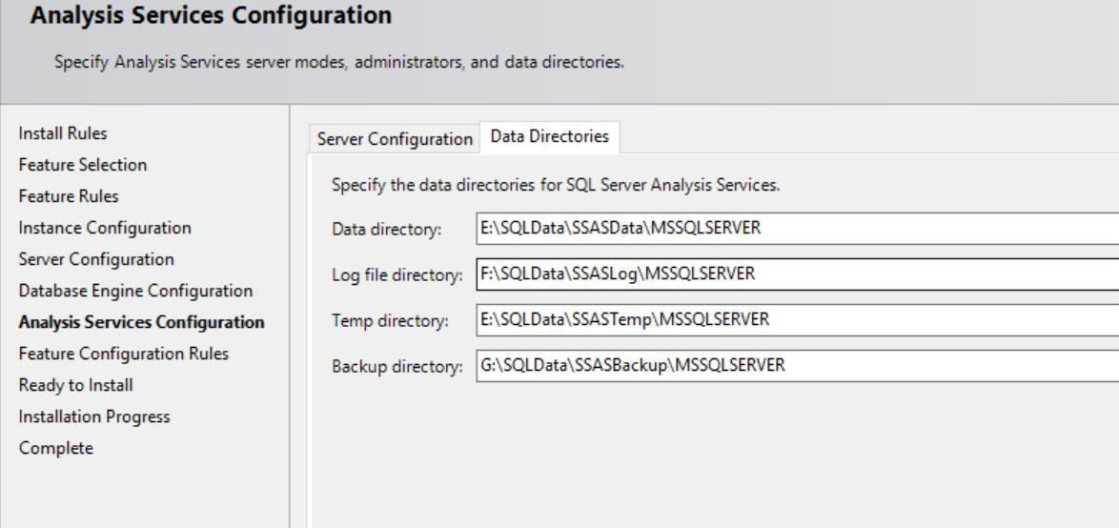
SQL server 2019 DEV END on USVAN-MES301

Slide 20
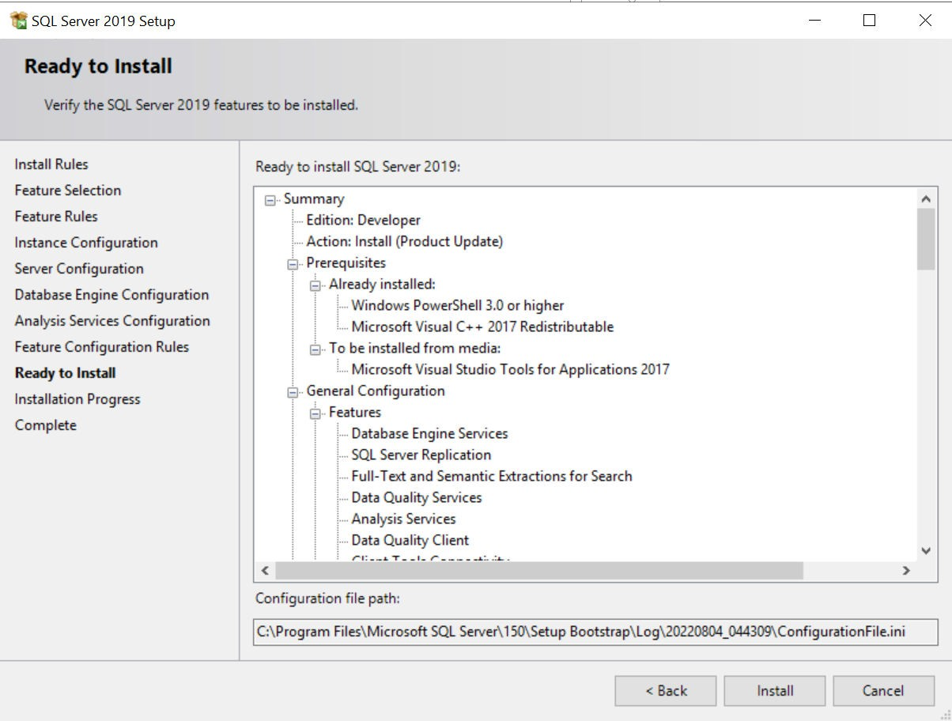
SQL server 2019 DEV END on USVAN-MES301

Slide 21
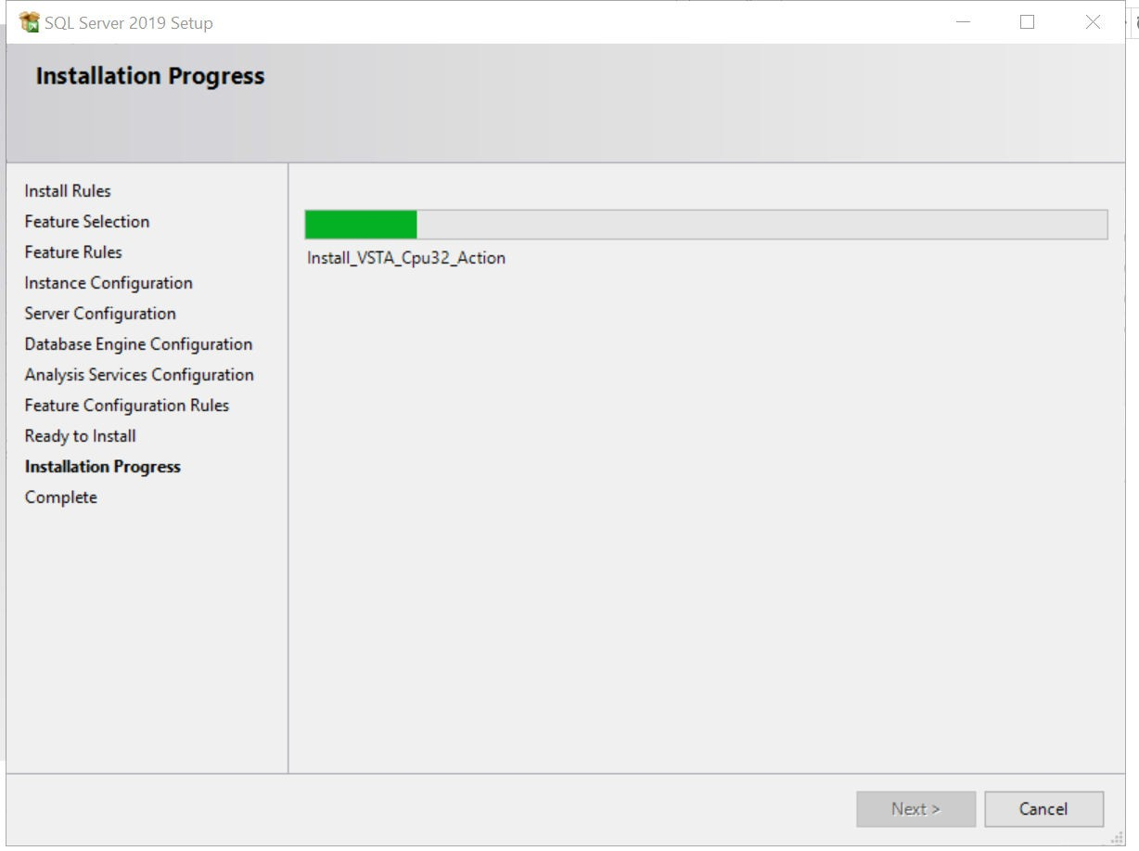
SQL server 2019 DEV END on USVAN-MES301

Slide 22
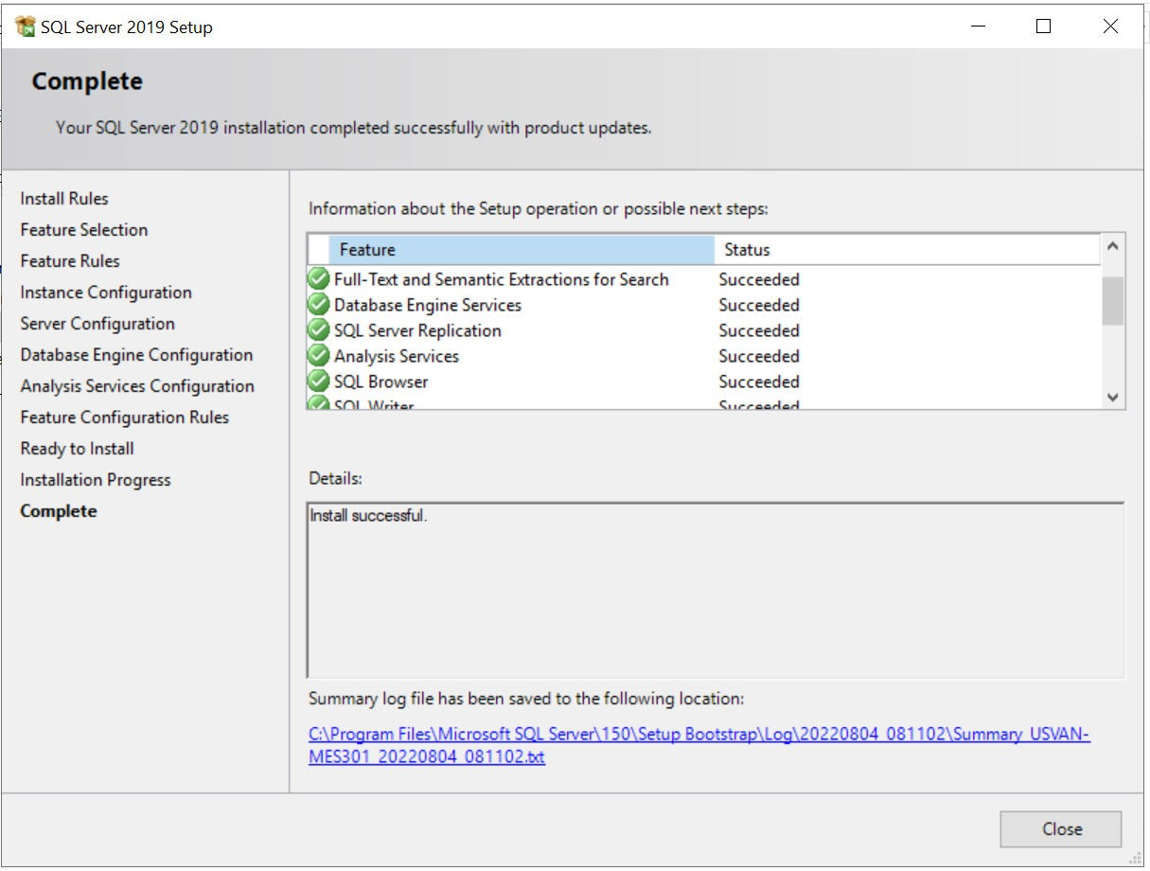
SQL server 2019 DEV END on USVAN-MES301

Slide 23
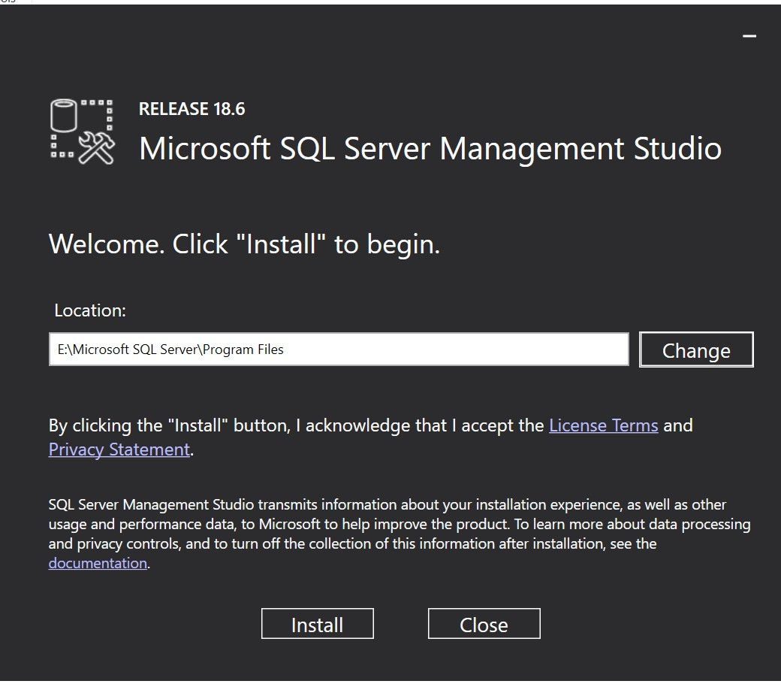
SQL server 2019 DEV END on USVAN-MES301
CU15

Slide 24
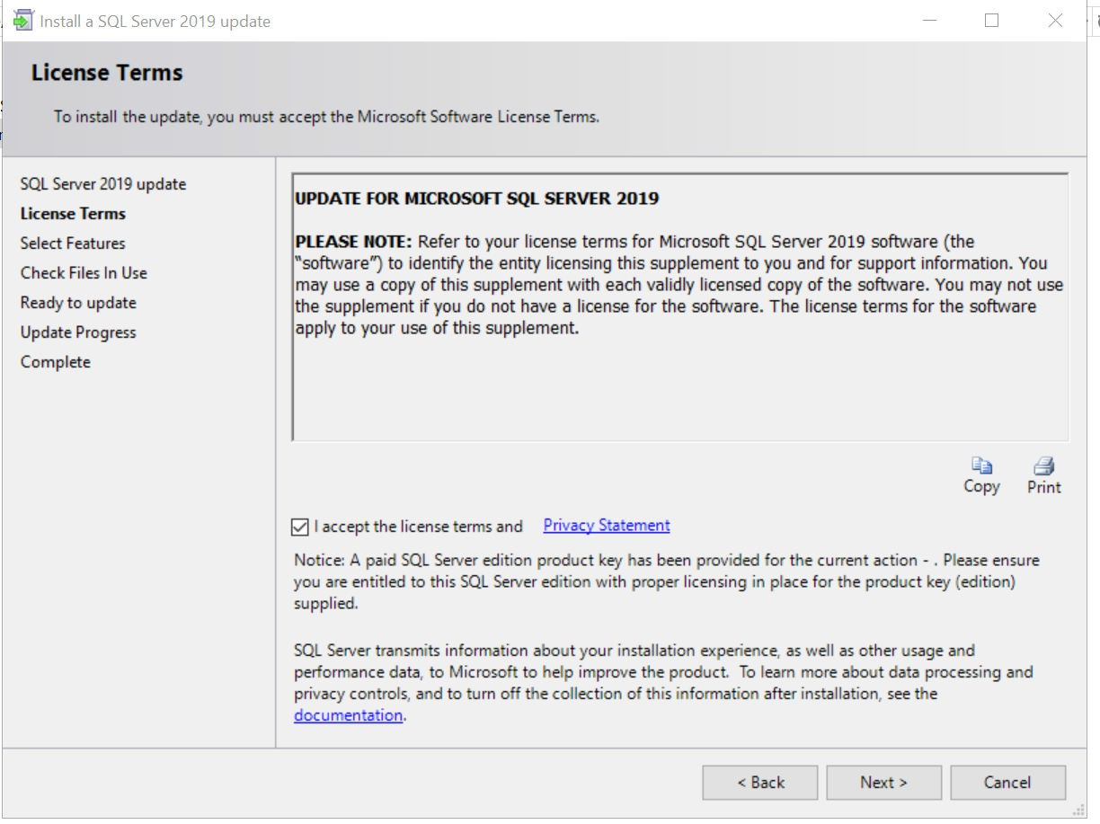
SQL server 2019 DEV END on USVAN-MES301

Slide 25
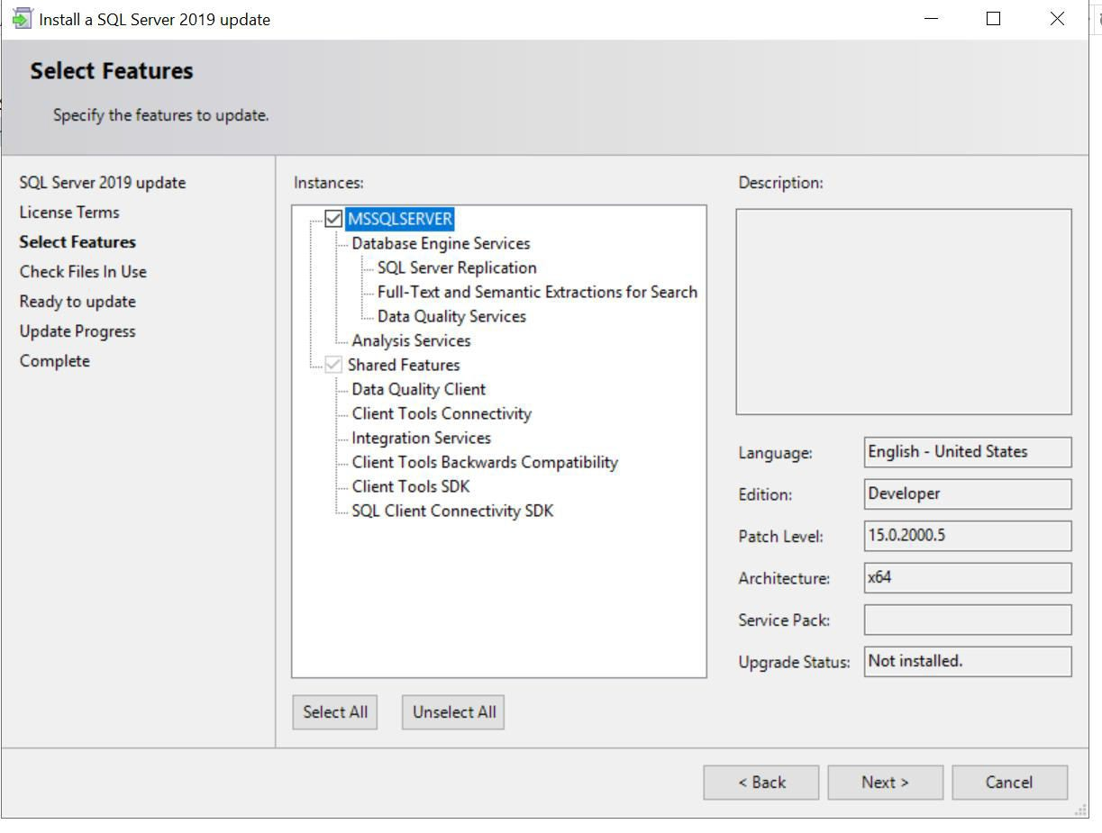
SQL server 2019 DEV END on USVAN-MES301

Slide 26
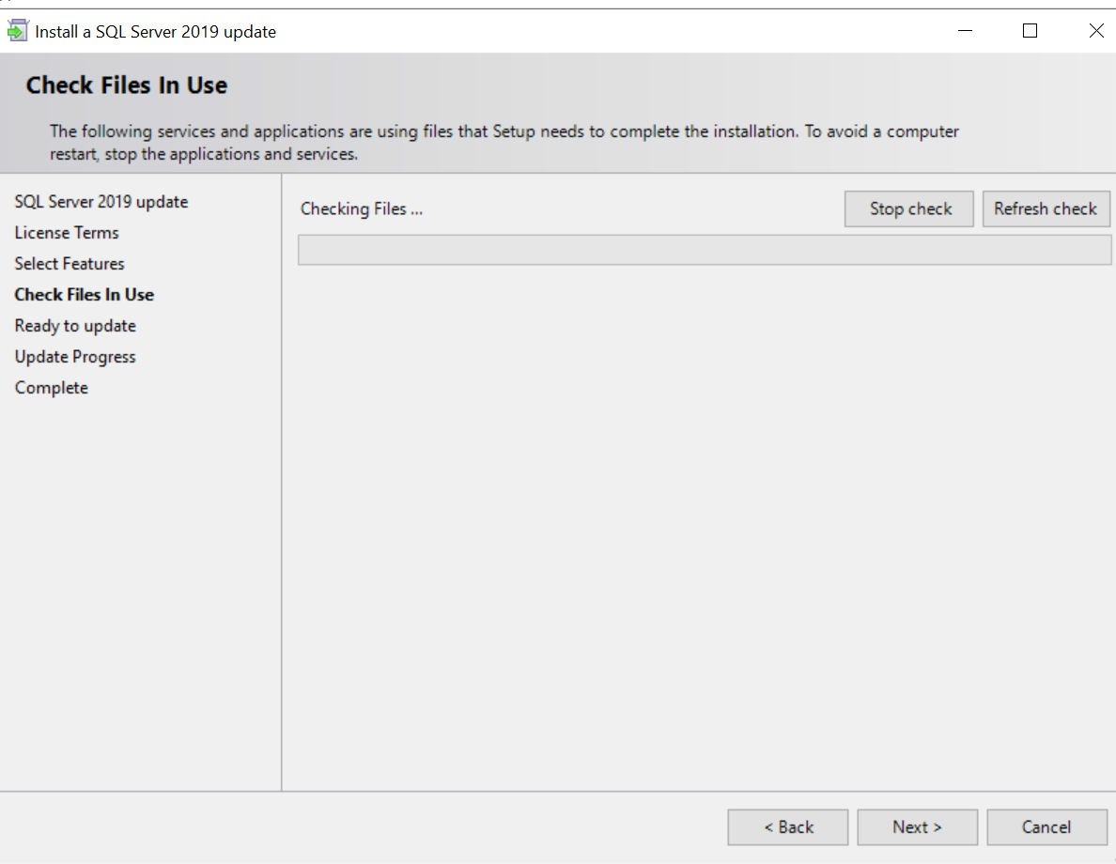
SQL server 2019 DEV END on USVAN-MES301

Slide 27
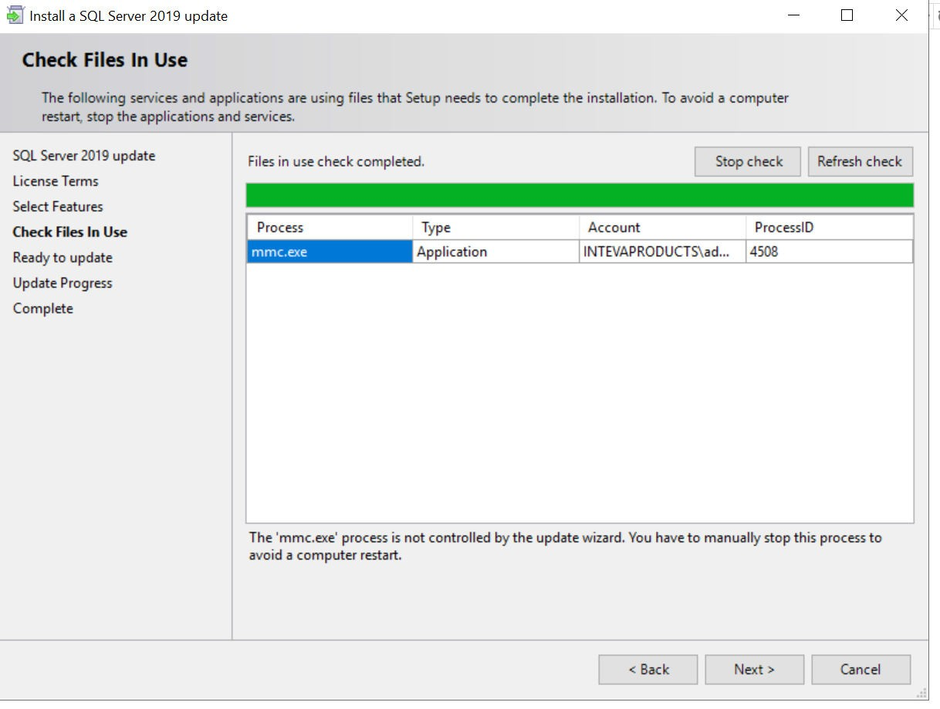
SQL server 2019 DEV END on USVAN-MES301

Slide 28
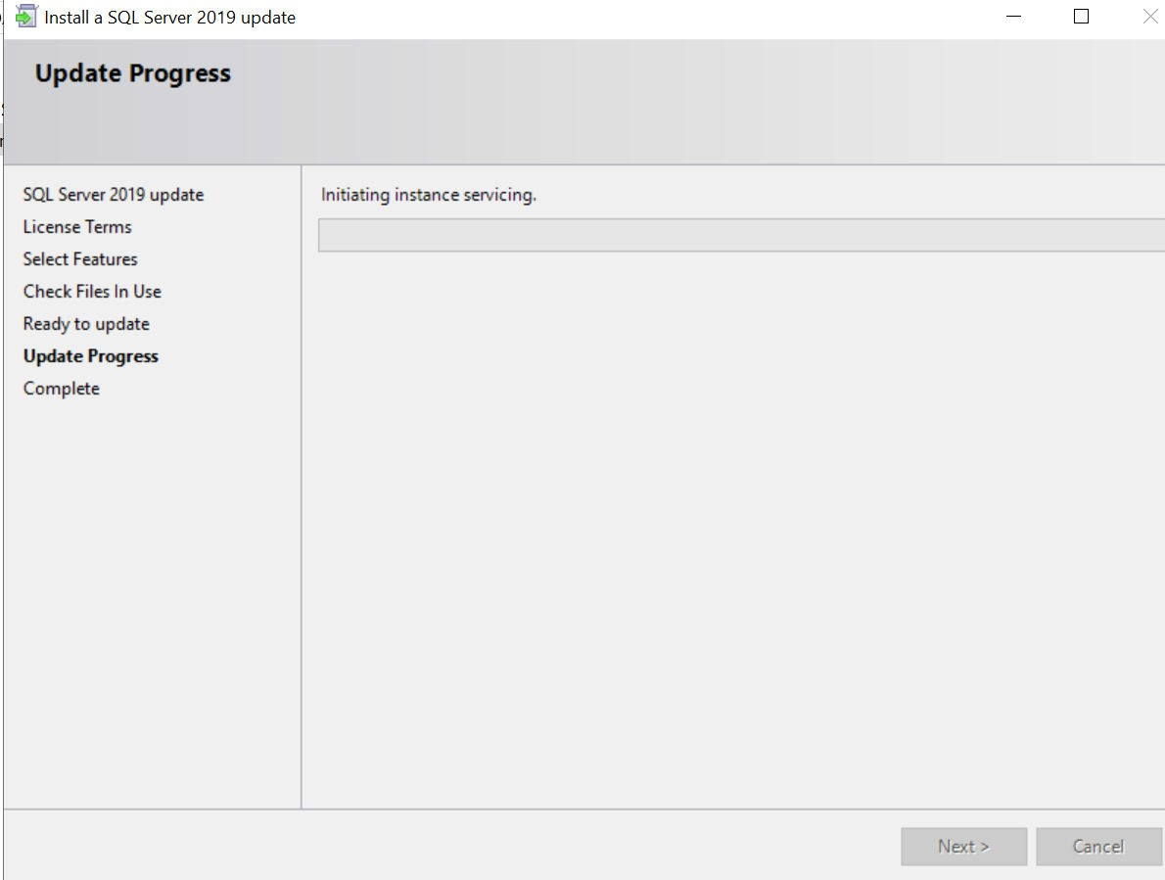
SQL server 2019 DEV END on USVAN-MES301

Slide 29
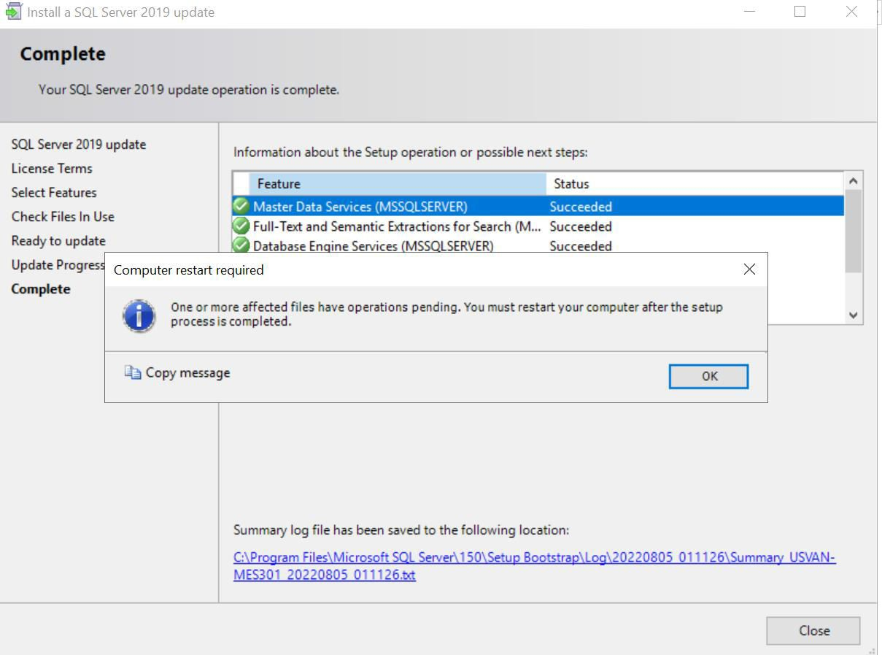
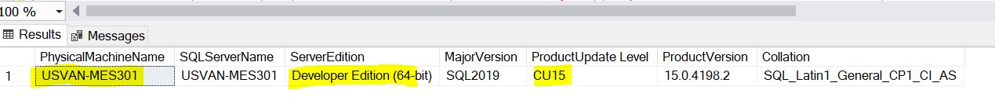
SQL server 2019 DEV END on USVAN-MES301

Slide 30
System databases
We have 6 System databases namely,
1.Master
2.Model
3.msDB
4.TempDB
5.Resources

Slide 31
Master :
1. Records all the system-level information of SQL Server.
2. such as server configuration settings, login accounts, system-wide
metadata, and information about all other Databases.
3. SQL Server cannot start if the master database is unavailable.
Model :
1. The model database is used as the template for all databases created on
SQL Server.
2. Any settings or objects added to the model database are automatically
copied to new databases.

Slide 32
MSDB :
Used by SQL Server Agent to store information about scheduled jobs, alerts, operators, and backup history.
Critical for managing and automating tasks in SQL Server.
By default, msDB uses the simple recovery model. If we use the backup and restore history tables, we recommend to use the full recovery model for msDB.
TempDB :
A temporary workspace used to store temporary tables, temporary stored procedures, and intermediate results.
This database is recreated every time the SQL Server service is restarted, meaning all data stored in tempdb is temporary and non-persistent.
Permanent objects cannot be created in this database.

Slide 33
Server Roles : we have 8 fixed server roles which cannot be change or alter,
(sp_srvrolepermission [securityadmin])
Role Description
sysadmin ====> Full control over the entire SQL Server instance.
serveradmin ====> Can configure server-wide settings.
securityadmin ====> Manages logins and server-level security settings.
processadmin ====> Can terminate running processes.
setupadmin ====> Can manage linked servers.
diskadmin ====> Manages disk-related operations.
dbcreator ====> Can create, alter, and restore databases.
bulkadmin ====> Can run BULK INSERT operations.

Slide 34
Database Roles : we have 9 fixed database roles
(sp_dbfixedrolepermission db_owner)
Roles Description
db_owner ====> Full control over the database.
db_securityadmin ====> Manages database security.
db_accessadmin ====> Controls database access.
db_backupoperator ====> Can back up the database.
db_ddladmin ====> Can execute DDL commands (CREATE, ALTER, DROP)
.
db_datawriter ====> Can insert, update, and delete data.
db_datareader ====> Can read all tables.
db_denydatawriter ====> Cannot insert, update, or delete data.
db_denydatareader ====> Cannot read any data.

Slide 35
Authentications
we have 2 types of authentications:
1.SQL server authentication
Who have SQL server access they will connect
using SQL server authentication
2.Windwos authentication
Who have admin access to windows machine they
will connect using windows account

Slide 36
SQL Sub-Languages:
In SQL we have 5 sub-languages or commands, namely:
DDL (Data Definition Language): Commands used to define and manage database structure.
Examples: CREATE, ALTER, DROP, TRUNCATE
DML (Data Manipulation Language): Commands used to manipulate data within the database.
Examples: INSERT, UPDATE, DELETE
DQL (Data Query Language): Commands used to retrieve data from the database.
Example: SELECT
TCL (Transaction Control Language): Commands to manage transactions.
Examples: COMMIT, ROLLBACK,
DCL (Data Control Language): Commands to control access to data.
Examples: GRANT, REVOKE

